Slide 1
A Nimble Spatial Analysis Framework for Transportation Planning Analyses
James McLane
North Central Texas Council of Governments
2019 TRB Planning Applications Conference
June 3, 2019

Slide 2
Background
Need for flexible GIS-based sketch planning tool
Need for easy-to-understand region-scale output
Many different spatial datasets inform transportation planning decisions
Often use different geography types
Not spatially coincident but in the same general area

Slide 3
Solution
Simple sketch planning doesn’t need complex solutions like conflation and linear referencing
Grid-based analysis creates useful “blob”-style regional output
Scoring and weighting process allows for parameters to be tweaked mid-analysis or for testing of scenarios
Long history of “blob”-style data visualization at NCTCOG

Slide 4
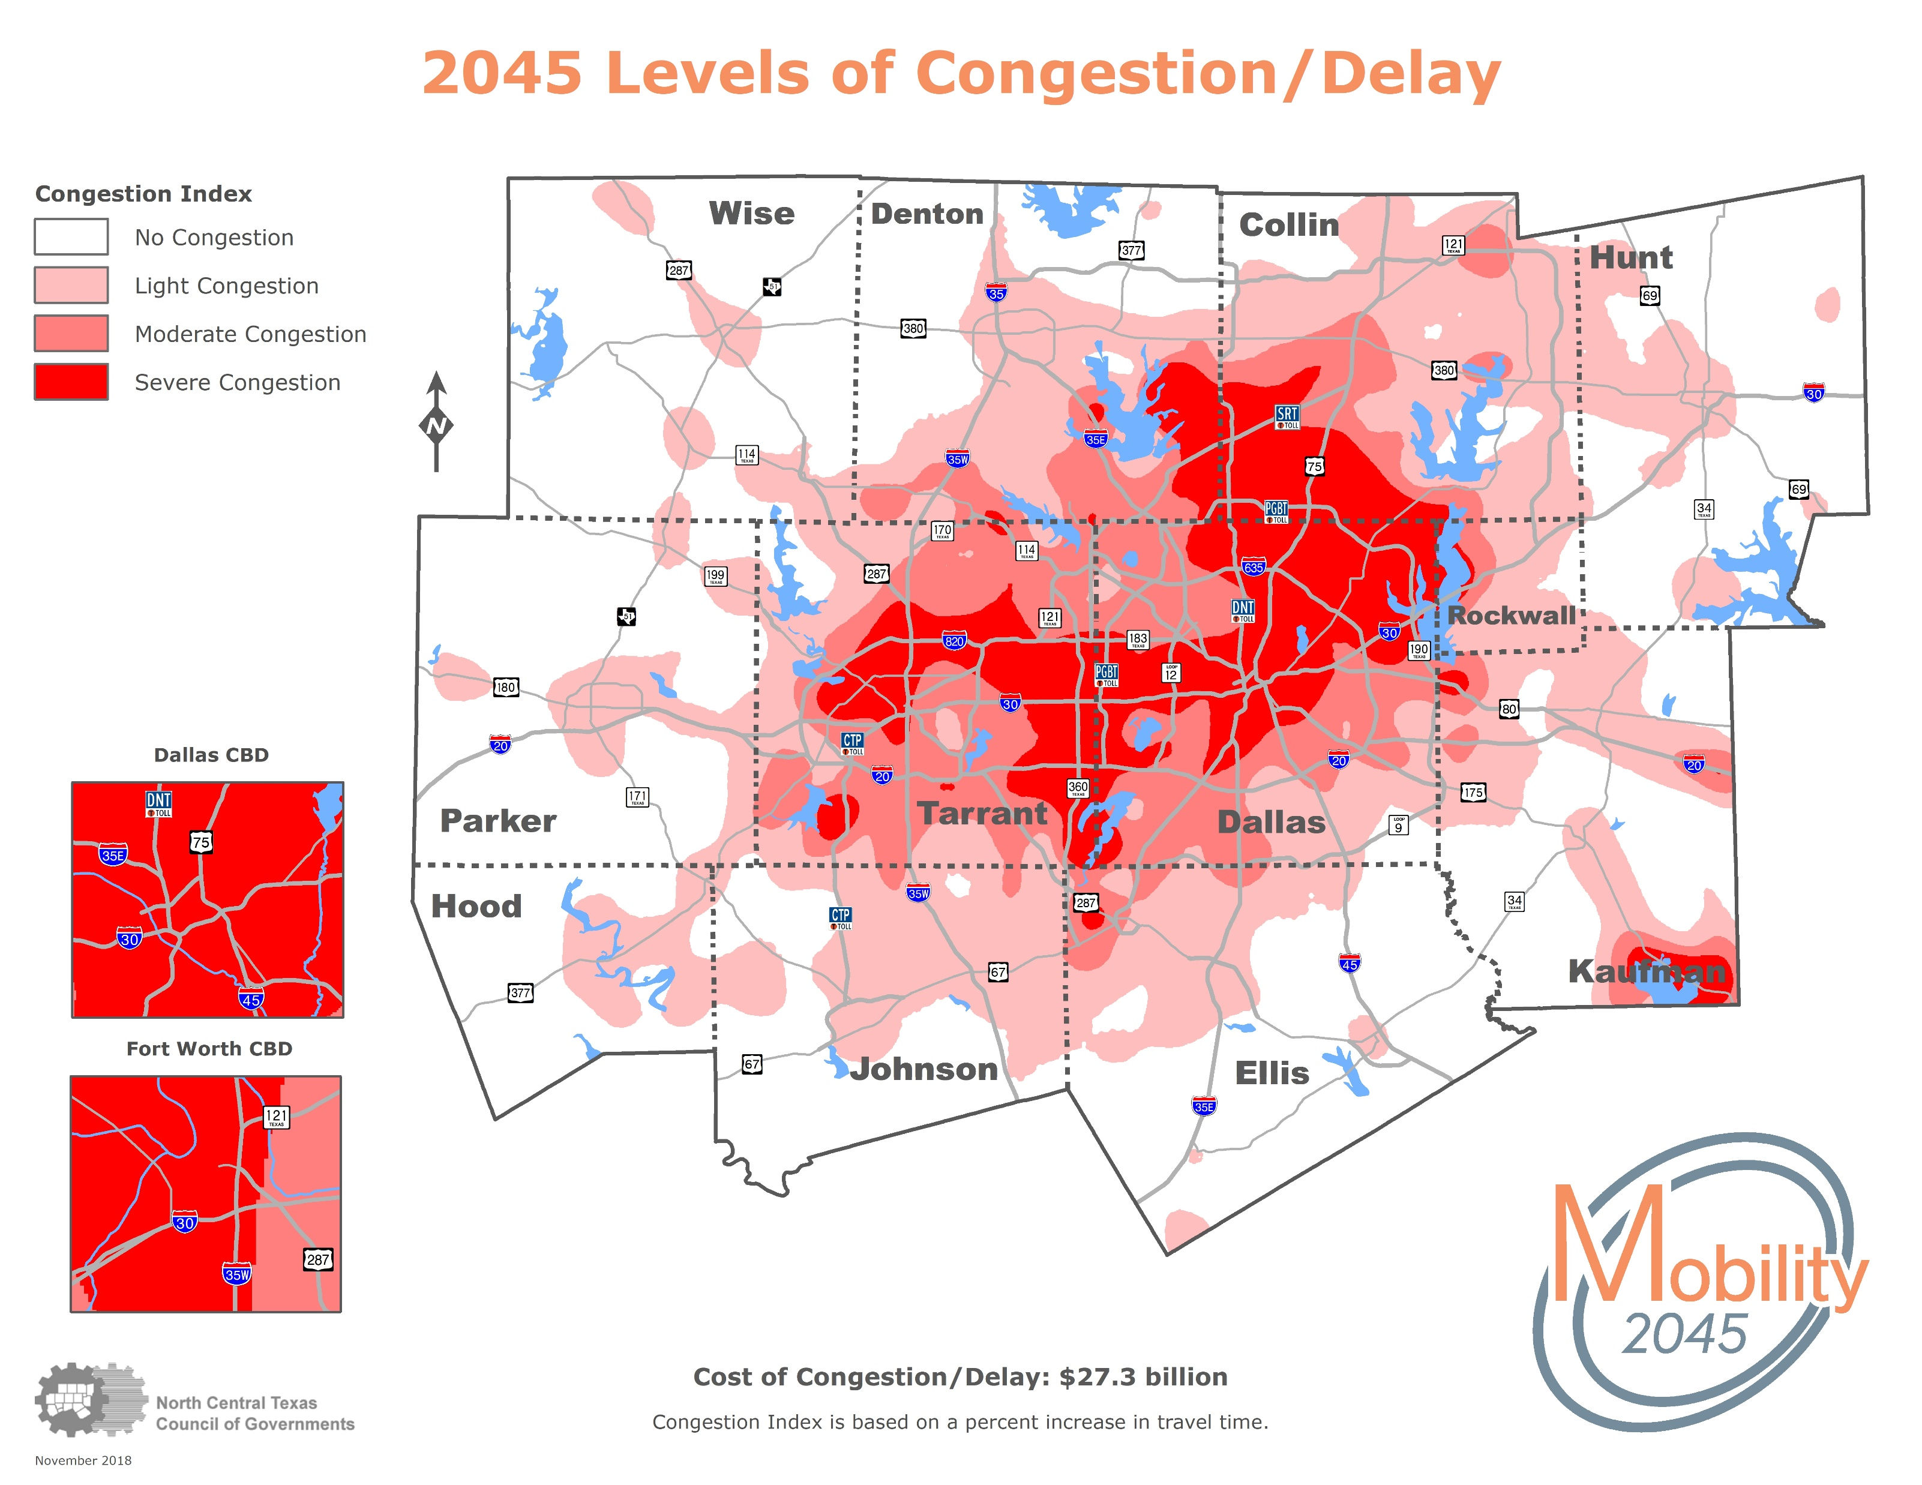

Slide 5
General Steps
Split study area into analysis grid
Intersect input variables with analysis grid
Summarize input variables and convert to indexes/scores
Weight specific scores for input variables and sum to final grid cell score
Use interpolation tools (Natural Neighbor, Kernel Density, etc.) to create smoothed output

Slide 6
People Mover Feasibility Analysis
Identifies areas where present land use characteristics may support modern people mover systems
Has been used to validate proposals and inform further studies
Considers:
Land use (conducive and prohibitive)
Demographic density
Employment mix
Airport proximity

Slide 7
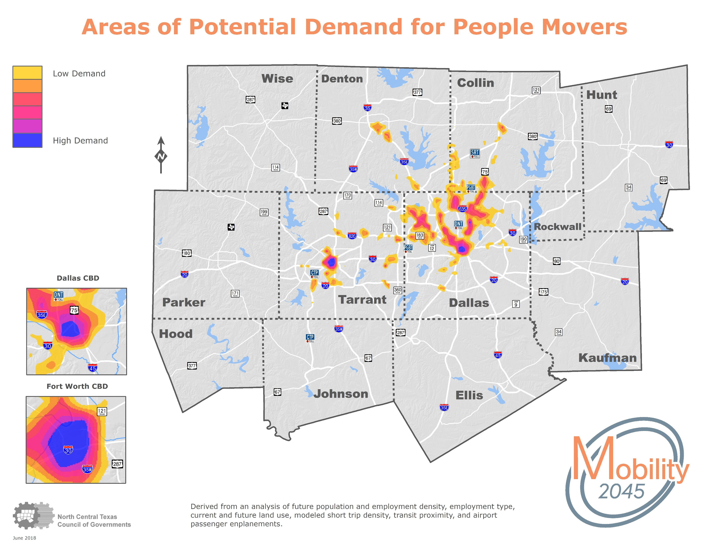
People Mover Feasibility Analysis
[map]

Slide 8
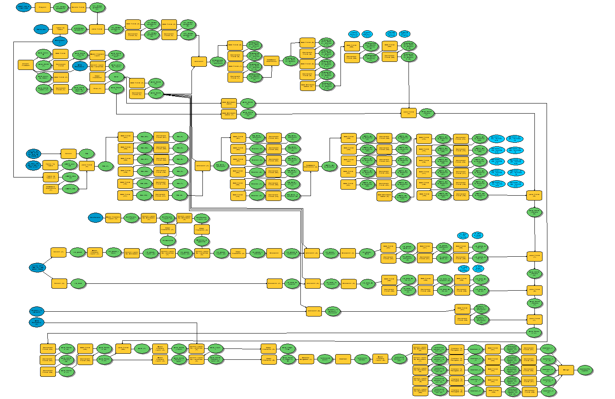

Slide 9
Arterial Needs Analysis
Identifies growth areas that may need expansion/creation of arterial streets
Generally meant to identify current need but could be applied to MTP out year to identify missed recommendations
Considers:
Demographic growth
Distance from existing arterials
Congestion (on arterials and all facilities)
Arterial connectivity/griddedness

Slide 10
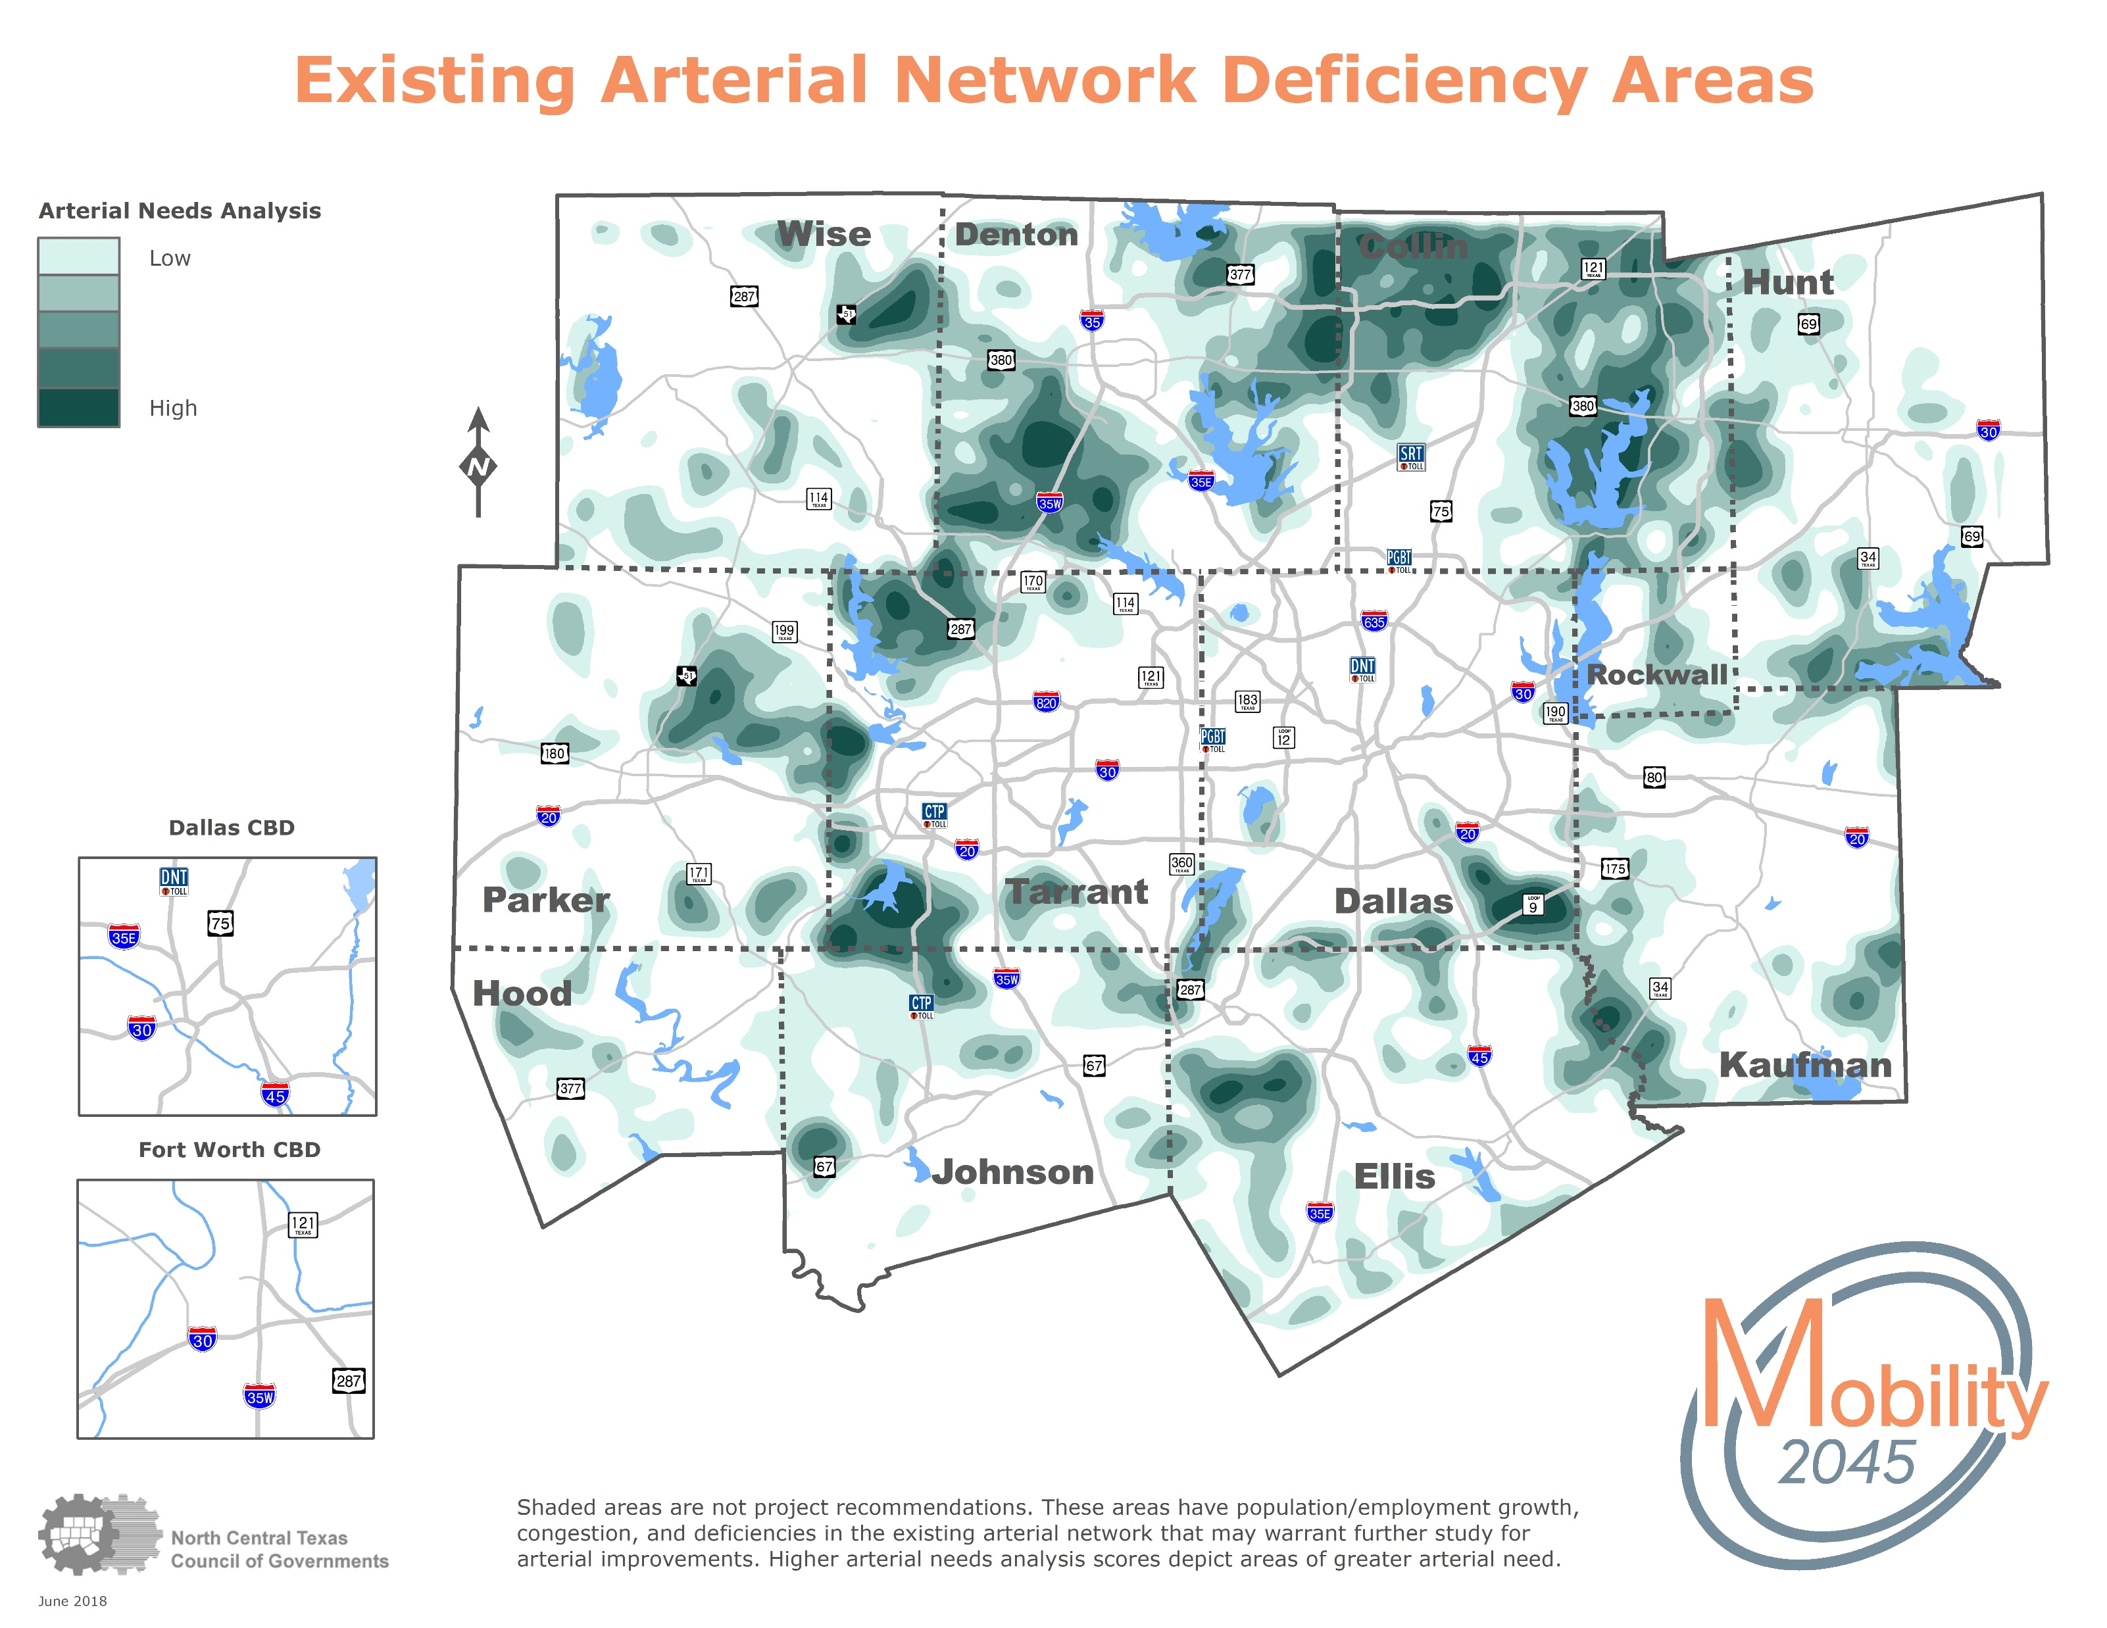
Arterial Needs Analysis
[map]

Slide 11
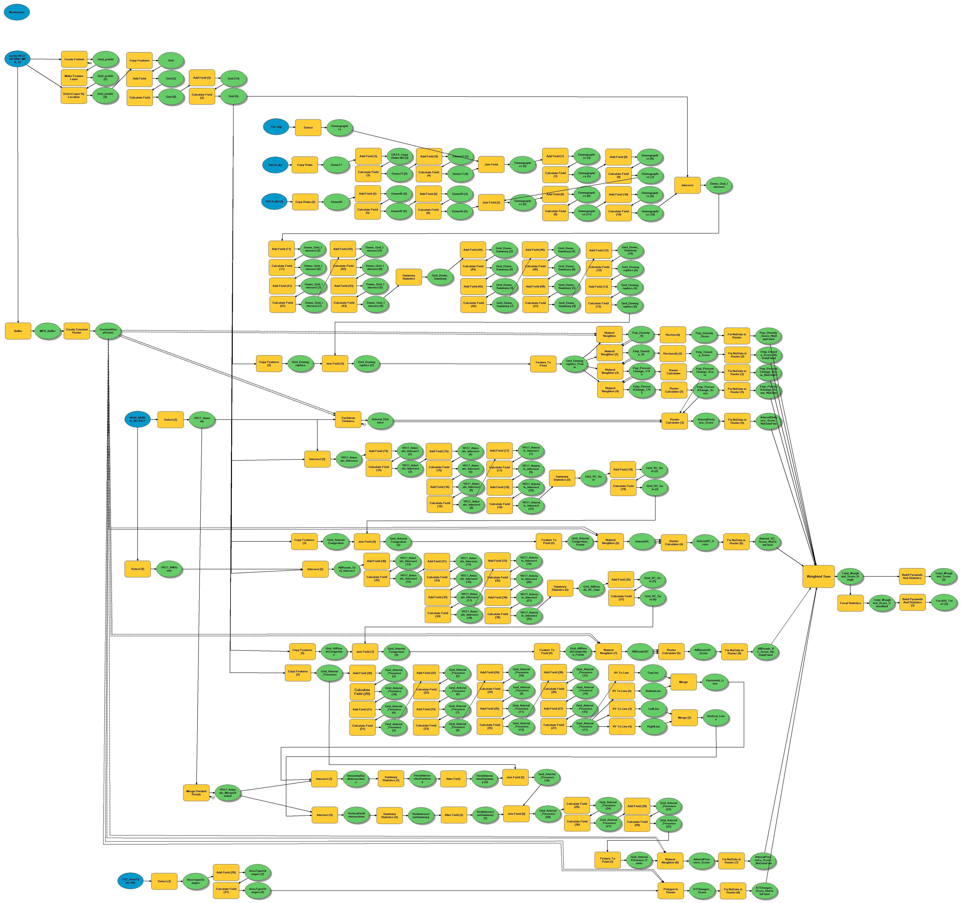

Slide 12
Flexibility
Easily adapted to answer new planning questions
Can be deployed relatively quickly
Framework and scoring process has buy-in from management
Scoring process allows for weighting input from staff, stakeholders, committees, etc.

Slide 13
Going Forward
Process could be developed into a defined tool or script with flexible inputs
Typically done with ArcGIS Model Builder, but is in the process of being ported to Python
Finding additional sketch planning applications

Slide 14
Questions?
James McLane
Senior Information Analyst
North Central Texas Council of Governments
817-704-5636
jmclane@nctcog.org

